Slide 1

Green Pace
Security Policy Presentation
Developer: Nicholas Jackson

Slide 2

OVERVIEW: DEFENSE IN DEPTH
The goal of this security policy is to establish a set of standards and best practices to protect our software and data. Each component of the policy contributes to the layered protection outlined in the Defense-in-Depth strategy.

Slide 3
THREATS MATRIX
Low Priority: Unlikely to happen with a low severity
Likely: Probable or likely to happen with a low severity
Unlikely: Unlikely to happen but with a high severity
Priority: Probable or likely to happen with a high severity
Likely STD-007-CPP | Priority STD-002-CPP STD-003-CPP STD-004-CPP STD-005-CPP STD-009-CPP STD-010-CPP
Low priority STD-006-CLG STD-008-CPP | Unlikely STD-001-CPP

Slide 4
10 PRINCIPLES
1 | Validate Input Data | STD-004-CPP
2 | Heed Compiler Warnings | STD-001-CPP, STD-002-CPP
3 | Architect and Design for Security Policies | STD-006-CPP, STD-007-CPP, STD-008-CPP
4 | Keep it Simple | STD-002-CPP, STD-004-CPP, STD-008-CPP, STD-010-CPP
5 | Default Deny | STD-009-CPP
6 | Adhere to the Principle of Least Privilege | STD-009-CPP
7 | Sanitize Data Sent to Other Systems
8 | Practice Defense in Depth | STD-005-CPP
9 | Use Effective Assurance Techniques | STD-003-CPP, STD-005-CPP, STD-007-CPP
10 | Adopt a Secure Coding Standard | STD-003-CPP, STD-008-CPP, STD-010-CPP

Slide 5
CODING STANDARDS
STD-004-CPP | Sanitize data passed to complex subsystems
STD-005-CPP | Properly deallocate dynamically allocated resources
STD-003-CPP | Range check element access
STD-008-CPP | Do not modify the standard namespaces
STD-002-CPP | Value-returning functions must return a value from all exit paths
STD-007-CPP | Handle all exceptions
STD-001-CPP | Never qualify a reference type with const or volatile
STD-006-CPP | Understand the termination behavior of assert() and abort()
STD-009-CPP | Close files when they are no longer needed
STD-010-CPP | Write constructor member initializers in the canonical order

Slide 6
ENCRYPTION POLICIES
Encryption at rest: data remains encrypted while stored, ensuring it is unreadable without the proper decryption key even if unauthorized access occurs. This is a critical safeguard so that, in the event of a breach, stolen data remains protected.
Encryption in flight: data moving from one location to another. Encrypting it during transfer ensures that, if intercepted, the contents remain inaccessible without the key.
Encryption in use: protecting data while it is actively being processed or modified. As encryption at rest and in transit become more common, data in use can become the weakest link. Therefore, it’s essential to implement methods that maintain encryption during use to ensure continuous security.

Slide 7
TRIPLE-A POLICIES
Authentication: the process of verifying a user’s identity, typically during account creation or login attempts. This policy applies whenever someone tries to access a system or its resources, ensuring the user is who they claim to be—often confirmed through credentials like a username and password.
Authorization: determining whether an authenticated user has permission to access the specific resources they request. It defines their level of access and prevents them from entering areas they are not permitted to use.
Accounting: tracking and logging all user activities, such as database changes or file access. This policy ensures visibility into system operations so that, if unusual behavior occurs, logs can be reviewed to identify the source of the issue and guide solutions.

Slide 8
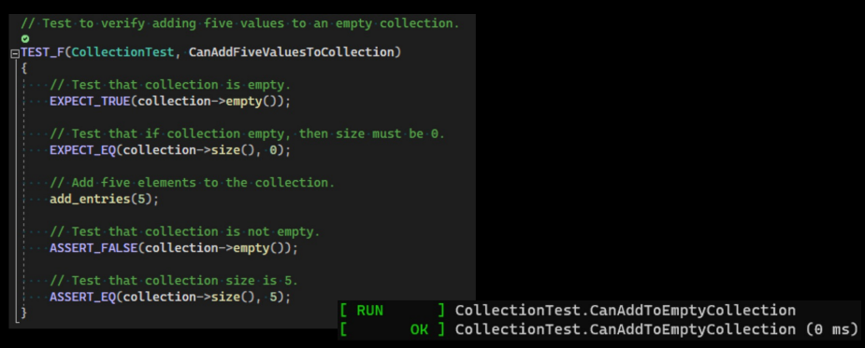
Unit Testing CanAddFiveValuesToCollection

Slide 9
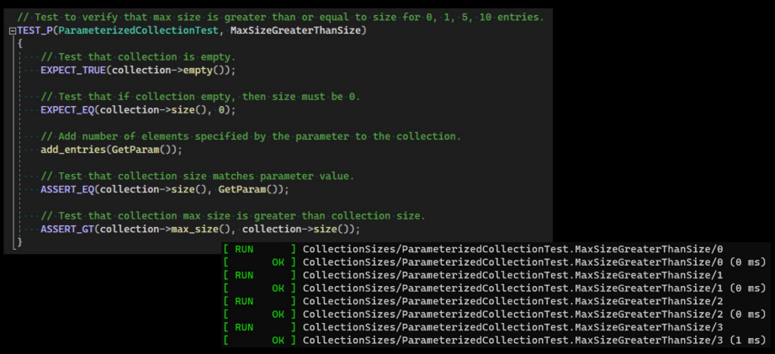
Unit Testing MaxSizeGreaterThanSize

Slide 10
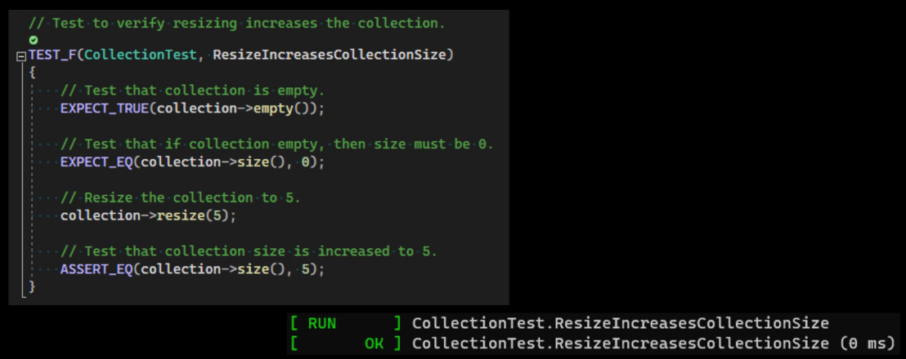
Unit Testing ResizeIncreasesCollectionSize

Slide 11
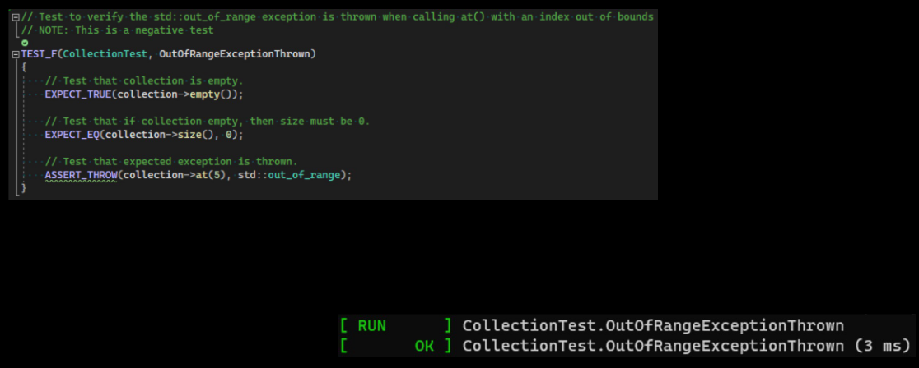
Unit Testing OutOfRangeExceptionThrown

Slide 12

AUTOMATION SUMMARY

Slide 13
TOOLS
The DevSecOps pipeline shows the flow the development process goes through
Pre-production: steps to design and test the software
Production: steps for deploying, monitoring, and maintaining the software
Design stage – OWSAP or Security Policy for creating a secure design
Build stage – IDE/compiler for compiling and running the code
Verify and Test stage – Static analysis and unit testing tools
Monitor and Detect stage – Logging and application monitoring tools

Slide 14
RISKS AND BENEFITS
Security should be implemented now, not later.
Security of your application and data is serious and must be treated as such
Security should be considered as soon as planning begins
Benefits
Easier to implement security when planned from the start
More robust/reliable code
More consistent code
Risks
Not enough buy-in
Can be difficult to go back and add security later
Applications breached and data exposed if taking a wait and see approach

Slide 15
RECOMMENDATIONS
A security policy that is understood and followed
DevSecOps training for developers
Automated monitoring of software dependencies for vulnerabilities and patches to prevent supply chain attacks
https://learn.microsoft.com/en-us/nuget/concepts/security-best-practices

Slide 16
CONCLUSIONS
Security must be considered from the beginning
Training must be provided on security and the security policy
Enforcement mechanisms should be in place to ensure the security policy is followed
Deployment of an application should not be possible without meeting security policy requirements
The security policy should be regularly reviewed and updated where needed

Slide 17
REFERENCES
Microsoft. (2025, August 15). Best practices for a secure software supply chain. Microsoft Learn. https://learn.microsoft.com/en-us/nuget/concepts/security-best-practices
SEI CERT C++ Coding Standard - SEI CERT C++ Coding Standard - Confluence. (n.d.). https://wiki.sei.cmu.edu/confluence/pages/viewpage.action?pageId=88046682

